Slide 1
CEIS 114 Final Project Component – Option 1
Creating a Multiple Traffic Light Controller with a Cross Walk and an Emergency Buzzer with secured IoT Control via Web

Slide 2
Final Project due Saturday of Week 8
This PowerPoint Deliverable is just a component of the Final Project.
To submit your Final Project, assemble all your previous project submissions into one professionally designed presentation.
You also need to include an introduction slide, conclusion slide, challenges in the project slide, and career skills obtained slide.
After you develop your final project presentation, upload your final project to your personal Wix site.
Once you upload this and other projects to Wix.com, you can showcase your projects to potential employers. This is a great way to demonstrate the skills you have obtained from the projects.

Slide 3
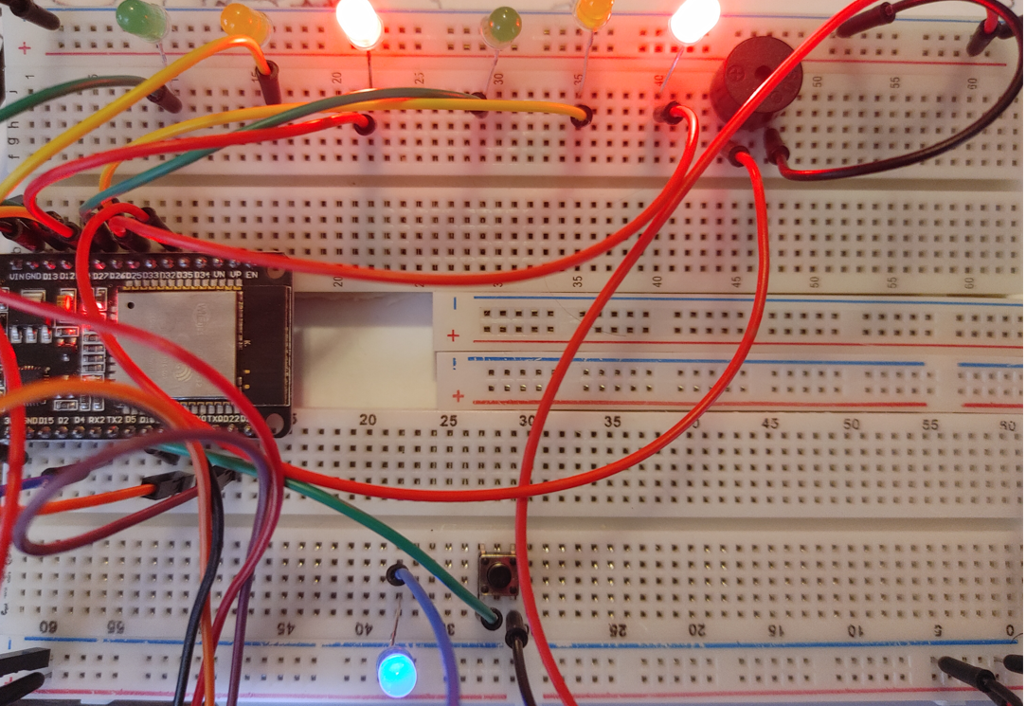
Picture of circuit with working LEDs and LCD display
ESP 32 Board
Colored LEDs: Red, Yellow and Green (two sets)
One Blue LED – Emergency Light
220 Ohm Resistors (optional)
Push Button
LCD Unit
Buzzer
Wires
Breadboard

Slide 4
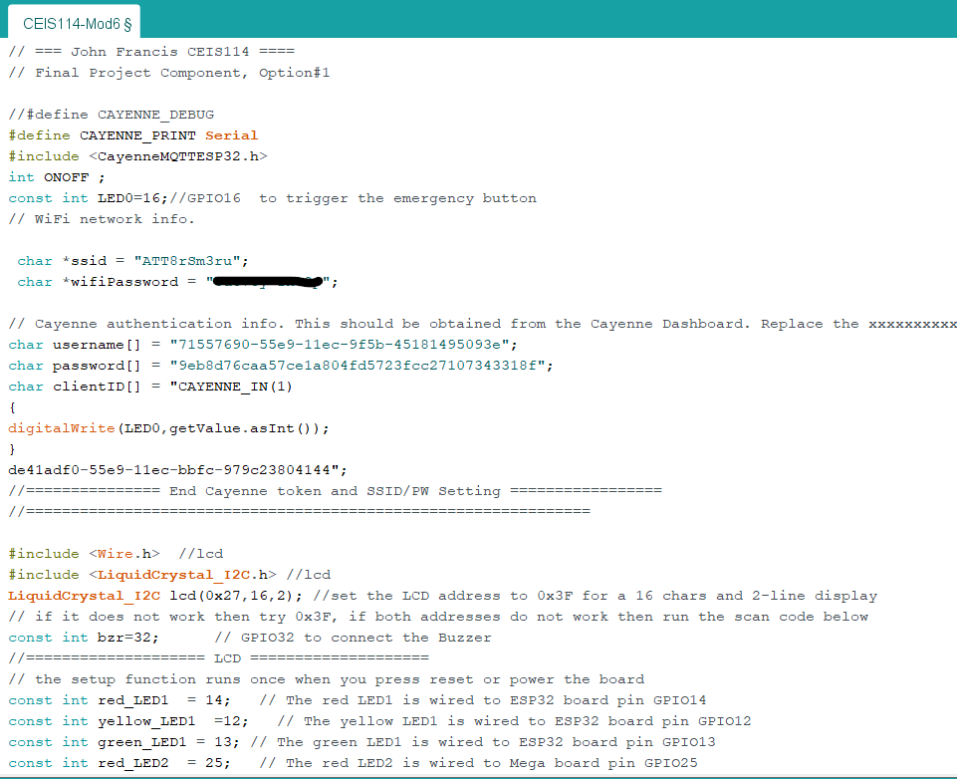
Screenshot of code in Arduino IDE
Screenshot of code in Arduino IDE showing your name in the comment

Slide 5
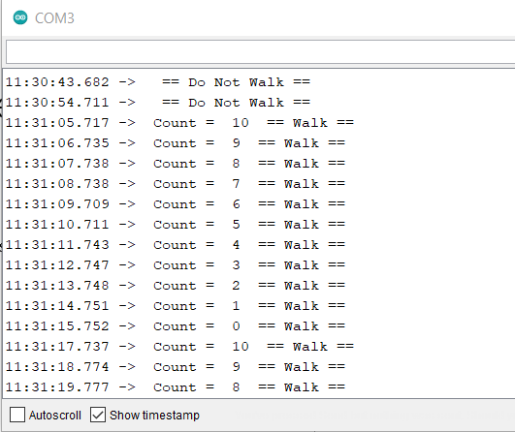
Screenshot of Serial Monitor in Arduino IDE
Screenshot of output in Serial Monitor

